Slide 1



Performance Testing tools
Notes:
Here are some Performance testing tools
and in this video we are going to explain Gatlin
So let’s start.

Slide 2
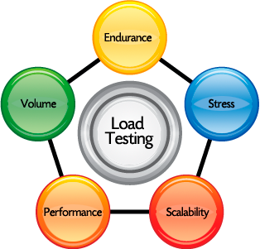
What and why are load tests?
Notes:
Now lets see What and why are load tests?

Slide 3

We Are VVnT Team
Notes:
So with this , we have come to the end of this video . We hope you guys find it informative and helpful.
Thanks for watching .

Slide 4
VVnT supports
#WeAllFitIn Campaign

